Slide 1
UI Resources
Layout Resources
String Resources
Image Resources

Slide 2
UI Resources
A non programming components of UI.
Help developer in laying out the visual structure of screen.
Along with string constant & images that populate the screens.
Other UI resource is
MENU :- A different way of user interaction & navigation in app

Slide 3
Layout Resources
Provides a visual blueprint of an activity.
Defines how the UI elements in a screen is arranged.
They are XML files located in the res\layout folder.
A layout file may be associated with one or more Activities.
YOU may recall the setContentView(R.layout.activity_main) method that associates an Activity with a layout file(activity_main.xml).

Slide 4
Upon creating a layout resources,Android frame work generates an unique id for it in the R.java file present in the gen folder .
The R.java file contain information about all nonprogramming components.
Using this a developer can resolve these resources inside programming component.

Slide 5
Example..
Layout file name-activity_main.xml
It is represented as an integer constant-public static final int activity_main-in the R.java file under a static class-layout
This is applicable to all nonprogramming components.
Public final class R{
public static final class layout {
public static final int activity_main=0x7f030000;
}
}

Slide 6
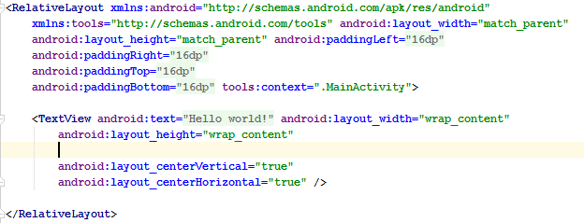
Layout file-activity_main.xml

Slide 7
Android provide layout editor to create the layouts. how to create a new layout file?
Layout editor:- provide a mechanism to drag & drop the UI components in the layout file to create the require UI.
The equivalent XML layout file gets generated automatically behind the scenes.
Apps have different requirement for arranging the UI elements(views);layout editor provides various ready to use layouts
Relative
Linear
Grid
table

Slide 8
Relative layout is the default layout of an activity.
Here views(UI elements)are arranged relative to to other views in that layout or the layout itself.
Thus rendering of views happens automatically without bothering diverse screen resolution, sizes or orientation.

Slide 9
To create a relative layout select it as the root elementfor the new android XML file.
Here there are two types of attributes that can be assign to the views.
Views relative to one another.
Views relative to layout itself.

Slide 10
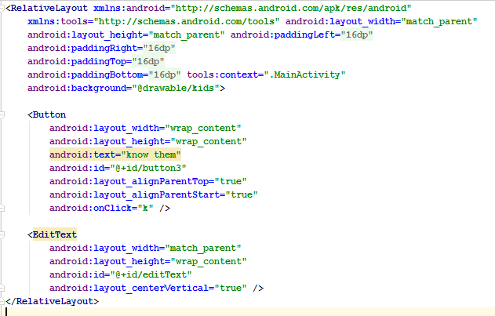

Slide 11
Do this..
EditText1 contains properties such as layout_alignParentLeft,layout_alignParentRight & layout_alignParentTop set to true
EditText1 is aligned to the left,right and top of the parent(Relativelayout).
Botton1 is aligned to right of its parent(Relativelayout)using the layout_alignparentRight attribute & below EditText1 using the layout_below attribute

Slide 12
Button2 is placed to the left of Button1 using layout_toLeftOf attribute.

Slide 13
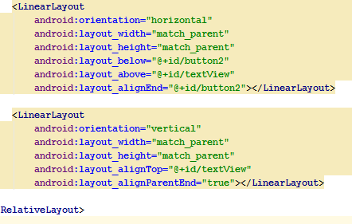
Linear layout ensure that UI element are placed either horizontally or vertically.
Defined by linear layout tag in the layout file.

Slide 14
The most important attribute of the linear layout is android:orientation .
The layout can also be nested.
Another important attribute of the LinearLayout is android:gravity.

